Slide 1
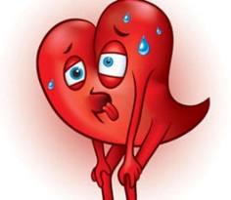
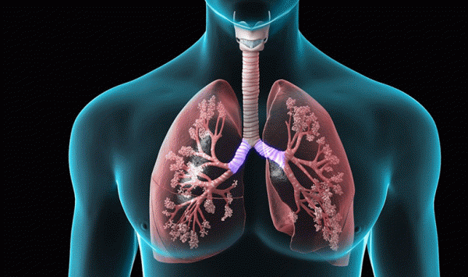
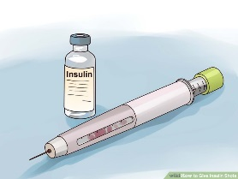
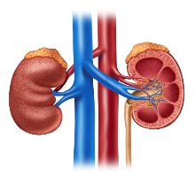
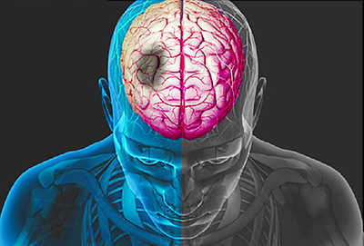
Chronic Disease Management
Created by: Kimiko Cheeley, MFT

Slide 2
Heart Failure
This is a condition that causes the muscles in the heart’s wall to weaken, and the heart can no longer pump enough oxygen rich blood throughout the body.
Some symptoms: shortness of breath or swelling in the stomach, hands, legs, and feet

Slide 3
Types of Heart Failure
Left-sided heart failure happens when the heart fails to pump out enough blood to the body. There are two types of left-sided heart failure.
Systolic failure: the left ventricle loses its ability to contract normally. The heart can’t pump with enough force to push enough blood in to circulation.
Diastolic failure: the left ventricle loses its ability to relax normally because the muscle is stiff. Thus the heart cannot fill properly with blood.

Slide 4
Heart Failure
Source: Google image

Slide 5
Types of Heart Failure Cont.
Right-sided heart failure occurs when the right side loses pumping power and the blood backs up in the body’s veins. This usually causes swelling in the legs, ankles and ascites(fluid) in the liver or GI track.
Right-sides heart failure usually occurs because of left-sided heart failure.

Slide 6
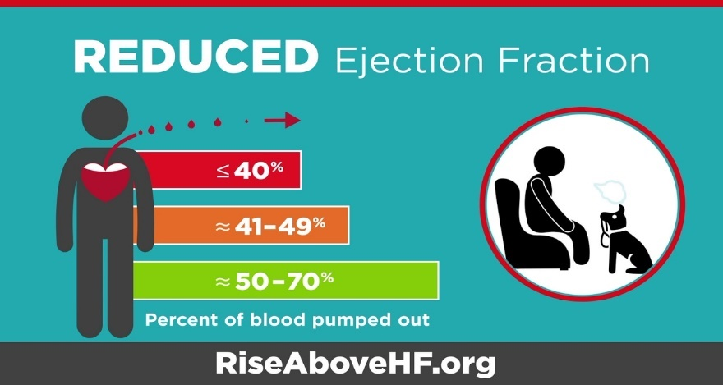
Heart Failure Testing
Echocardiogram (ECHO).
this is an ultrasound of the heart
Shows if there is problem with the heart muscles
Shows how well the heart pumps and the condition of the heart valves
Measures the ejection fraction (EF) –which estimates how strong the heart pump
Source: American Heart Association

Slide 7
Heart Failure Medical Treatment
Most daily treatment of heart failure includes:
Taking medication and weight daily to watch for fluid buildup
Eating less salt and limiting fluids
Balancing low-level exercise and rest
Reducing demands on the heart when possible

Slide 8
Medication
Some medicine to treat heart failure
1. Diuretics: causes you to pass urine. This helps lower the amount of blood the heart has to pump.
2. ACE inhibitors and ARB’s: these medications relax the blood vessels and make the heart workload easier over time.
3. Beta or a beta-and alpha-blocker: offer long term benefits to make the heart’s workload easier
4. Digoxin: help to control the heart rate
Take medication as prescribed!!!

Slide 9
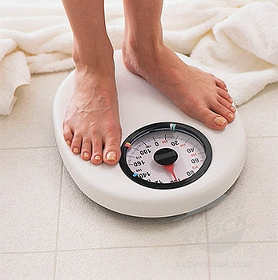
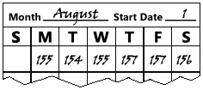
Weighing
Weighing should be done every day on the same scale.
The scale should remain on a hard surface.
A record of the weight should also be kept and taken to doctor’s appointments.
The doctor should be notified if a person is gaining 2 pounds overnight or 5 pounds in a week.

Slide 10
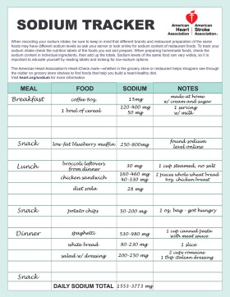
Salt/Sodium
The American Heart Association recommends no more than 2,300 milligrams (mgs) a day and an ideal limit of no more than 1,500 mg per day for most adults
Source: American Heart Association
1/4 teaspoon salt = 575 mg sodium
1/2 teaspoon salt = 1,150 mg sodium
3/4 teaspoon salt = 1,725 mg sodium
1 teaspoon salt = 2,300 mg sodium

Slide 11
Fluid
The doctor may limit fluid intake to 2 quarts (64 ounces) a day. This includes all beverages, high-moisture foods/fruits, Jell-O, ice cream and ice cubes.
Small amounts of hard sugar free candy can help with dry mouth.

Slide 12
Exercise/Rest
Rest throughout the day.
Put feet up for a few minutes
Consider taking a nap at lunch.
Speak to the MD about taking walks or other exercises.

Slide 13
Chronic Obstructive Pulmonary Disease (COPD)
COPD is a condition that happens when lung disease blocks air from flowing easily within the lungs. There is no cure for COPD and the damage it causes is not fully reversible. Symptoms may include shortness of breath, coughing, wheezing and too much mucus in the lungs.

Slide 14
Types of Lung Diseases
Emphysema occurs when the air sacs in the lungs lose their ability to relax and let air out of the lungs. One may cough if the air is trapped in the lungs and have shortness of breath when the sacs loses its elasticity.
Chronic Bronchitis comes from swollen or inflamed lining of the bronchial tubes. Inflammation causes more mucus, and the extra mucus causes coughing and wheezing.
Asthma occurs when the windpipe (trachea) and the bronchial tubes are sensitive. Exposure to certain things causes the bronchial tubes to tighten.

Slide 15
Types of Lung Diseases
Cystic Fibrosis -this is a hereditary disease that make children prone to having a defect in the glands that affect the respiratory and digestive systems.
Bronchiectasis- occurs when the bronchial tube walls become inflamed, enlarged, and swollen. This weakens the tube walls and form scar tissue. People with cystic fibrosis are more likely to develop bronchiectasis.
Pulmonary Fibrosis -is when tissue deep in the lungs becomes thick, stiff and scarred. The scaring is called fibrosis and it makes it difficult for a person to breath.
Sarcoidosis- happens when a white blood cell that protects the body from disease triggers a buildup of inflammatory cells in the body. The building up of the cells causes damage to the bronchial tubes and air sacs. This causes normal tissue to become stiff.

Slide 16
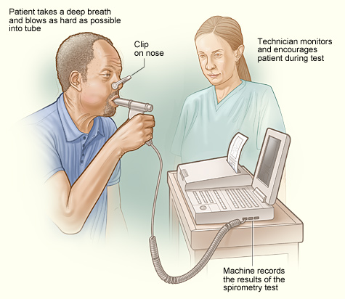
COPD Testing
The main test for COPD is spirometry. During this test the patient takes a deep breath and blows as hard as possible into a tube connected to a machine called a spirometer.
Source: National Heart, Lung, and Blood Institute

Slide 17
COPD Medical Treatment
Treatment is based on individual needs but may involve:
Breathing exercise
Physical exercise
Taking medicine
Managing extra mucus
Eating nutritious foods
Avoiding things that may cause breathing problems

Slide 18
Breathing Exercise
Source link: https://www.youtube.com/watch?v=7kpJ0QlRss4

Slide 19
Medication
Bronchodilators: relaxes the muscles which tighten around the airways. They help relieve shortness of breath and chest tightness.
Corticosteroids: reduces swelling in the lining of the airways; decrease the inflammation and mucus production. Must be used regularly and do NOT have an immediate effect.
Water pills (diuretics): increase the rate at which you may urine. When you have less fluid on the body, the heart and lungs do not have to work as hard.
Antihistamines: help block allergic reaction to things that causes breathing problems.
Decongestants: help reduce swelling in nasal passages.

Slide 20
Managing Mucus
Drink plenty of liquid to help thin the mucus
Your doctor will tell you how much to drink
It will take about 2 to 4 days before notice mucus to thin
Although you can drink other fluids, water is best
Drink very little caffeine
Don’t take antihistamines or diuretics unless your doctor tells you to.

Slide 21
Diet
A balance diet helps increase energy levels, maintain weight and helps your body fight off illness.
It takes extra oxygen to digest food. When a person has a lung disease, they may be short of breath when trying to digest large amount of food.
This process also creates more carbon dioxide which will need to be exhaled through the lungs.
Certain foods produce a higher amount of carbon dioxide than others do.
Not all people with lung disease need to follow the same diet. Use the plan the doctor or nutritionist provides.

Slide 22
Preventing Infection
Wash hands often
Stay away from sick people
Take medication
Exercise
Eat a balanced diet
Ask the doctor about getting a pneumonia shot
Keep a waterless hand cleaner handy
Get 7 to 8 hours of sleep nightly
Conserved energy
Keep lungs clear of mucus
Get a flu short every year
Don’t smoke and don’t allow smoking in the home

Slide 23
Diabetes
Diabetes is a problem with the body that causes blood glucose (sugar) levels to rise higher than normal. This is also called hyperglycemia.
When a person eats, the body breaks down food into glucose and sends it into the blood. Insulin then helps move the glucose from the body into the cells.
When glucose enters the cells it either use the fuel for energy or store it for later.
When a person is diabetic, it is something wrong with their insulin.

Slide 24
Types of Diabetes
Type 1- This type is usually diagnosed in children and young adults, and was previously known as juvenile diabetes. The body treat the cells that make insulin as invaders and destroys them, thus the body eventually does not produce insulin. Only 5% of people with diabetes have this form of the disease.
Type 2- This is when the body does not use insulin properly. This is called insulin resistance. At first, the pancreas makes extra insulin to make up for it. However, over time it cannot keep up and can't make enough insulin to keep the blood glucose at normal levels.

Slide 25
Diagnosing Diabetes
A1C: The A1C test measures the average blood glucose for the past 2 to 3 months. Diabetes is diagnosed at an A1C of greater than or equal to 6.5%
Fasting Plasma Glucose (FPG): This test checks the fasting blood glucose levels. Fasting means not having anything to eat or drink (except water) for at least 8 hours before the test. Diabetes is diagnosed at fasting blood glucose of greater than or equal to 126 mg/dl
Oral Glucose Tolerance Test (OGTT): a two-hour test that checks the blood glucose levels before and 2 hours after drinking a special drink. It tells the doctor how the body processes glucose. Diabetes is diagnosed at 2-hour blood glucose of greater than or equal to 200 mg/dl
Random(Casual) Plasma Glucose Test: This test is a blood check at any time of the day when severe diabetes symptoms are present. Diabetes is diagnosed at blood glucose of greater than or equal to 200 mg/dl

Slide 26
Treatment
Daily treatment of diabetes includes:
Monitoring blood glucose
Creating a meal plan
Exercising
Taking medication
Maintaining overall health

Slide 27
Monitoring Blood Glucose
Source: Google Image

Slide 28
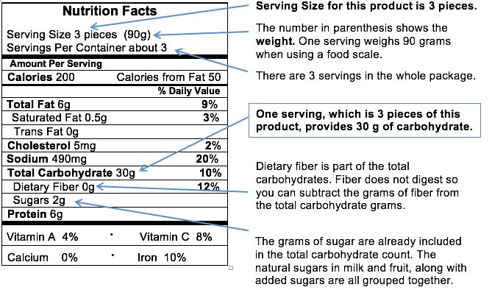
Meal Plan
The key to controlling blood glucose is eating healthy foods every day. Ask to meet with a registered dietitian. They will teach the skills needed to plan a healthy, diabetes-friendly meals.
To sustain energy, the body needs carbohydrates. However, the more carbohydrates eaten, the higher the blood glucose may rise.
Source: Diabetes Teaching Center at the University of California
Counting carbs helps tracks carbohydrates eaten at each meal.
The plate method helps with portion sizes
Source: American Diabetes Association

Slide 29
Exercise
Being physically active every day helps manage blood glucose, blood pressure and cholesterol.
If daily activity is new, start slow and steady.
Try to do a total of at least 150 minutes per week of face pace walking, spread over 3 or more days a week.

Slide 30
Medication
Some people with type 2 diabetes can manage their diabetes with healthy eating and exercise.
However, the doctor may need to also prescribe oral medications (pills) and/or insulin to help meet the target blood glucose levels.

Slide 31
End Stage Renal Disease (ESRD)
When the kidneys become damaged, they stop working properly. Waste product and fluid will begin to build up in the body causing swelling, vomiting, weakness, poor sleep, and shortness of breath. This stage of kidney disease is called Acute Kidney Injury (AKI) or Acute Renal Failure (ARF).

Slide 32
ESRD
The final stage of chronic kidney disease is kidney failure. The kidneys stop working and the body will not function properly without dialysis or a kidney transplant. In most cases, kidney failure is permanent and is called End Staged Renal Disease.

Slide 33
Kidney Function Tests
BUN: Blood Urea Nitrogen measures waste in the blood that would be otherwise filtered into urine with normal kidney function. Normal range is 7-20 mg/dL
Creatinine: a creatinine blood test measures the amount of creatinine in the blood. Normally, the kidneys will filter creatinine, and it will be released in the urine. The normal range is .7-1.3 mg/dL.
Microalbumin: this is a urine test to check the level of albumin, or protein, in the urine. In a person with normal kidney function, there should be little to no albumin in the urine.
GFR: The Glomerular Filtration Rate blood test measures how much blood can pass through the kidney in one minute. It is used to stage kidney disease.

Slide 34
Treatment
Dialysis is a treatment to filter waste and water from the blood, allowing people with kidney failure to feel better and continue doing the things they enjoy.

Slide 35
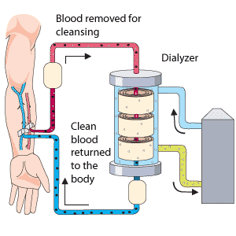
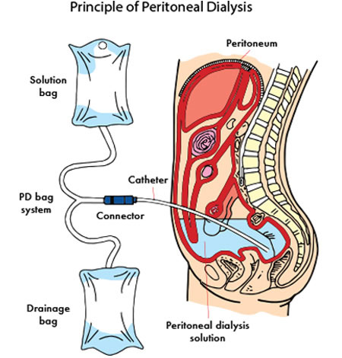
Types of Dialysis
Hemodialysis: it is the most common dialysis. It uses a filter to remove waste and clean the blood before returning it back to the body. Treatment takes 3 to 4 hours and done 3 times a week.
Source: Lucenxia
Peritoneal Dialysis: this dialysis uses the lining in the abdomen to filter the blood. It works by putting special fluid in the abdomen to absorb waste produced from the body as it passes through the small blood vessels. The fluid with the waste products is then drained away
Source: National Kidney Foundation

Slide 36
Stroke
Blood vessels that carry blood to the brain from the heart are called arteries. A stroke occurs when one of the arteries to the brain is either blocked or bursts. As a result, part of the brain does not get the blood it needs, so it starts to die.

Slide 37
Types of Strokes
Ischemic- the most common type of stroke. This occurs when an artery in the brain is blocked. There are two main types of ischemic strokes:
- Embolic Stroke: A blood clot or plague piece forms, usually in the heart or the large arteries leading to the brain, and then moves through the bloodstream to the brain. In the brain, the clot blocks a blood vessel and leads to a stroke.
- Thrombotic stroke: a blood clot forms inside an artery that supplies blood to the brain. The clot interrupts blood flow and causes a stroke.

Slide 38
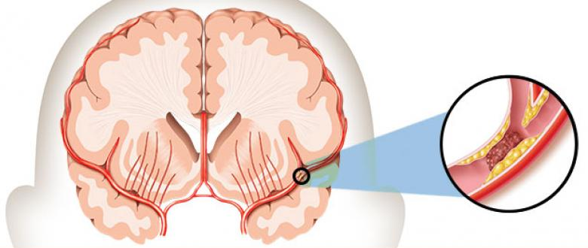
Types of Strokes
Hemorrhagic- this occurs when a blood vessel in the brain bursts. Blood leaks out and can injure or irritate the brain tissue, or cause damage by pushing into other areas. High blood pressure is the most common cause of this type of stroke.
Source: American Stroke Association

Slide 39
Warning Signs
Sudden numbness or weakness of the face, arm, or leg
Sudden confusion, trouble speaking, or understanding
Sudden trouble seeing in one or both eyes
Sudden trouble walking, dizziness, loss of balance, or loss of coordination
Sudden severe headache with no known cause
Source: American Stroke Association

Slide 40
Test
CT Scan (Computerized Tomography) called a CAT scan. This takes pictures of the inside of the body. CT scan will be taken to determine if a person has had a hemorrhagic stroke.
MRI (Magnetic Resonance Imaging). The MRI machine uses large magnets and computer to make pictures of the body.
Arteriogram or Angiogram- this test uses dye to look at blood flow in the brain or other parts of the body.
Carotid Ultrasound- this uses sound waves to look at the blood flow in the carotid arteries in the neck. These are the main arteries that take blood to the brain.

Slide 41
Medication
Anticoagulants (blood thinners)- are medicines that slows the clotting of the blood. It makes it harder for clots to form or keep existing clots from growing. Examples are: heparin, warfarin and dabigatran

Slide 42
Hypertension (High Blood Pressure)
Blood pressure is the force of the blood pushing against the blood vessel walls. So, when the pressure in the arteries are higher than is supposed to be, you have high blood pressure, which is also called hypertension.
Normal blood pressure should be below 120/80 mm Hg. High blood pressure is a pressure that stays high over time at 130/80 or higher.

Slide 43
Hypertension Testing
The best way to test for hypertension (high blood pressure) is to have blood pressure measured. This is done by taking the reading with a pressure cuff (sphygmomanometer).
Source: American Heart Association

Slide 44
Hypertension Medical Treatment
Taking medication
Weight management
Diet
Physical activity
Moderation of alcohol consumption

Slide 45
Medication
Diuretics: causes you to pass urine to get rid of extra salt (sodium) and water to help control blood pressure.
Beta-blockers: lower the heart rate, the work load of the heart and the amount of blood put out, which lowers blood pressure.
ACE inhibitors: helps the body produce less angiotensin (a chemical that causes the arteries to become narrow), which helps the blood vessels relax and open up, thus lowering your blood pressure.
Calcium channel blockers: prevents calcium from entering the smooth muscle cells of the heart and arteries. They relax and open narrowed blood vessels, reduces heart rate and lower blood pressure.

Slide 46
Helpful Sites/References
American Diabetes Association- http://www.diabetes.org/
American Heart Association- http://www.heart.org/HEARTORG/
American Lung Association- http://www.lung.org/
American Stroke Association- http://www.strokeassociation.org/STROKEORG/
Diabetes Education Online- https://dtc.ucsf.edu/living-with-diabetes/
National Heart, Lung, and Blood Institute- https://www.nhlbi.nih.gov
National Kidney Foundation- https://www.kidney.org/
http://www.lucenxia.com.my/page/154/Hemodialysis/

